Slide 1
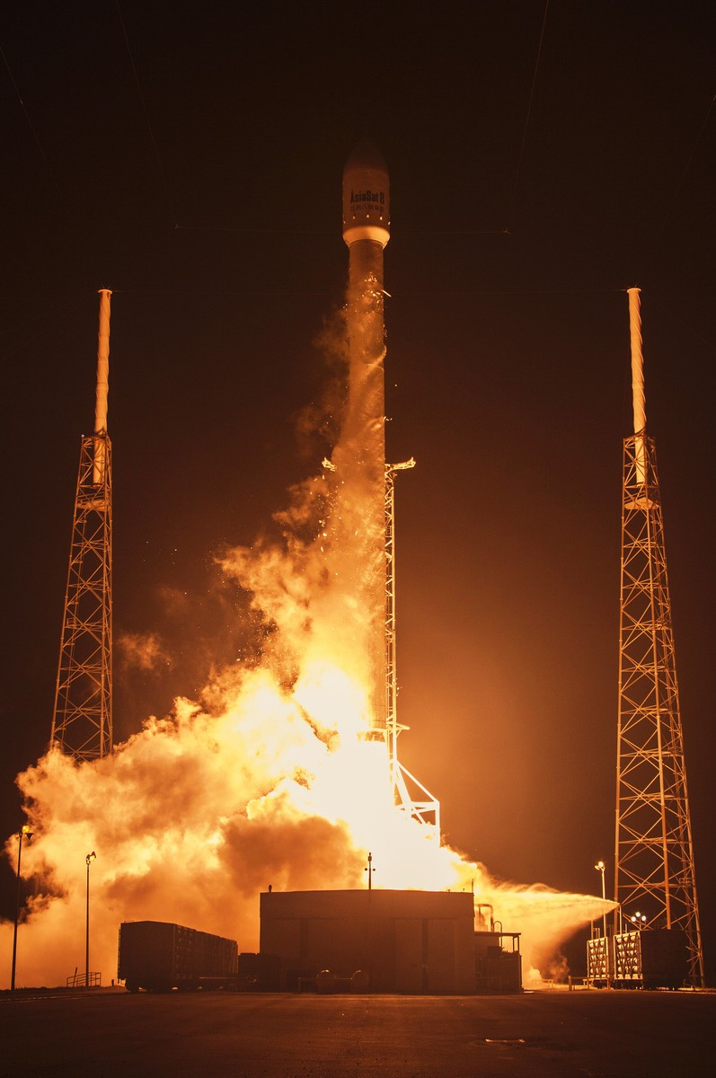






SPACEX FALCO-9 CAPSTONE PROJECT
Yasser Shabbir
15th January 2024

Slide 2



OUTLINE
Executive Summary
Introduction
Methodology
Results
Visualization – Charts
Dashboard
Discussion
Findings & Implications
Conclusion
Appendix

Slide 3

EXECUTIVE SUMMARY
Data Collection
Data Wrangling – done with
Pandas
Numpy
Exploratory Data Analysis.
. SQL
Visualization.
Predictive Analysis with Machine Learning.

Slide 4
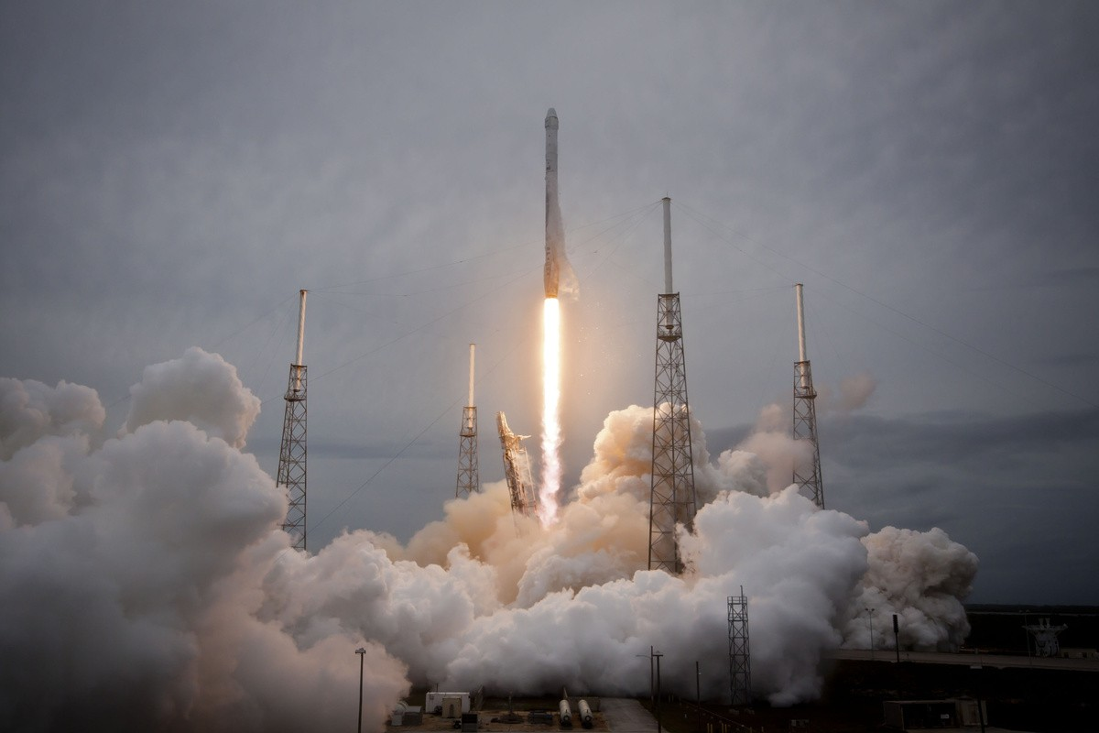
INTRODUCTION
Space-X Goal
Sending spacecraft to the international space station.
Providing satellite internet to the whole world with Starlink technology.
Taking people and cargo into space and contributing to space exploration.

Slide 5

FALCON 9 ROCKETS
Falcon 9 is a two-stage reusable rocket developed and manufactured by SpaceX, a private aerospace company founded by Elon Musk. Here are some key features and missions of Falcon 9 rockets
Reusability: One of the notable features of Falcon 9 is its reusability. The first stage of the rocket is designed to return to Earth after launch, landing vertically either on land (at SpaceX's landing zones) or on an autonomous drone ship in the ocean. This reusability significantly reduces the cost of space launches.
Payload Capacity: Falcon 9 is capable of delivering a variety of payloads to orbit, including satellites, cargo resupply missions to the International Space Station (ISS), and even crewed missions. It has a payload capacity of up to 22,800 kilograms (50,300 pounds) to low Earth orbit (LEO) and up to 8,300 kilograms (18,300 pounds) to geostationary transfer orbit (GTO).

Slide 6
Starlink: Falcon 9 plays a crucial role in SpaceX's ambitious Starlink project, which aims to provide global broadband internet coverage from a network of thousands of small satellites in low Earth orbit. Falcon 9 launches numerous batches of Starlink satellites to gradually build up the constellation.
Satellite Deployment: Falcon 9 is frequently used to deploy satellites for commercial customers, government agencies, and scientific research. It offers the flexibility to deliver satellites into different orbits, such as LEO, GTO, and sun-synchronous orbit (SSO).

Slide 7

METHODOLOGY
Data Collection through Web-Scrapping from Spacx API
Performed Exploratory Data Analysis (EDA) and Visualization with Structure Queried Language (SQL), Folium, Plotly.
Performed Predictive Analysis with Machine Learning using
Logistic Regression
K- Nearest
Decision Tree
Support Vector Machine

Slide 8
RESULTS
Data Collection
Api: spacex_url="https://api.spacexdata.com/v4/launches/past"
Web page:
"https://en.wikipedia.org/w/index.php?title=List_of_Falcon_9_and_ Falcon_Heavy_launches&oldid=1027686922"

Slide 9
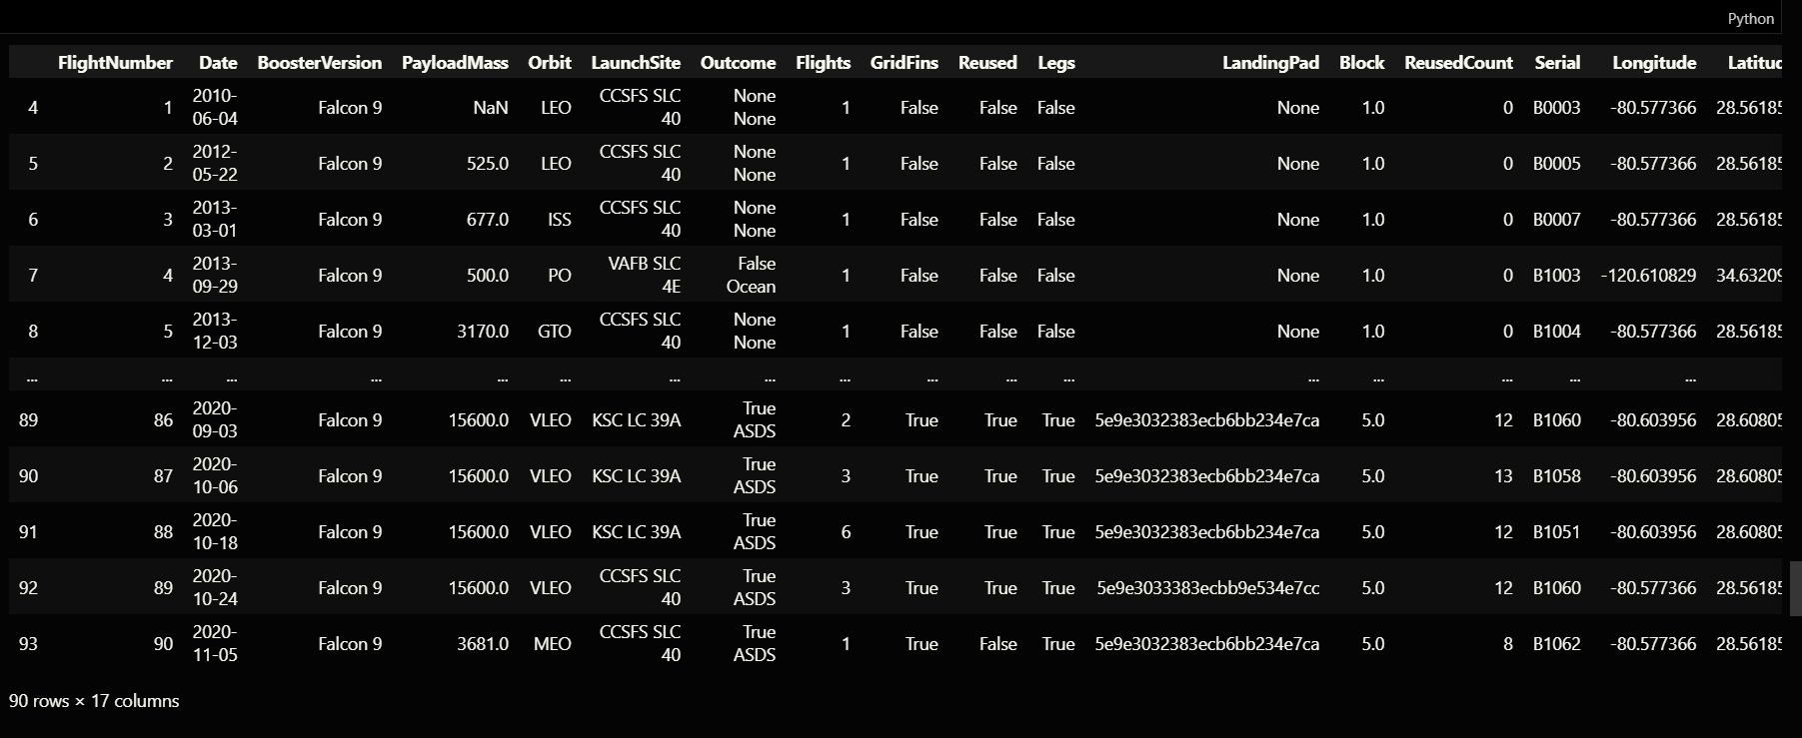
RESULTS
Data Collection - SpaceX API
Request and parse the SpaceX launch data using the GET request Filter the dataframe to only include Falcon 9 launches
Web Scrapping - Wikipedia
Web scraping Falcon 9 and Falcon Heavy Launches Records from Wikipedia
Request the Falcon9 Launch Wiki page from its URL
Extract all column/variable names from the HTML table header Create a data frame by parsing the launch HTML tables

Slide 10
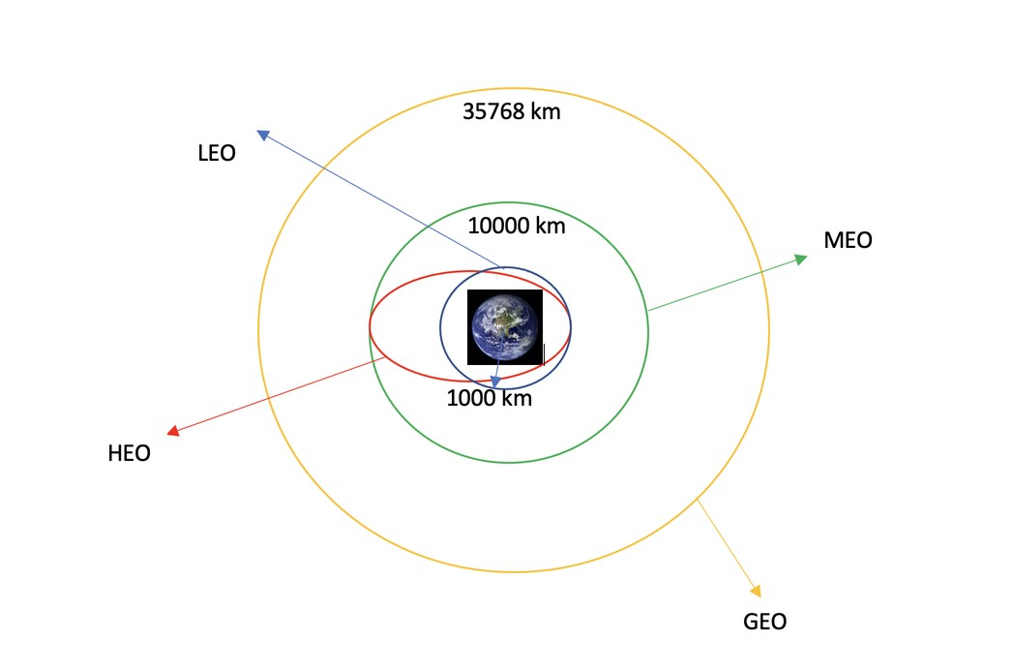
RESULTS
Data Wrangling
Calculate the number of launches on each site Calculate the number and occurrence of each orbit
Calculate the number and occurrence of mission outcome per orbit type Create a landing outcome label from Outcome column

Slide 11
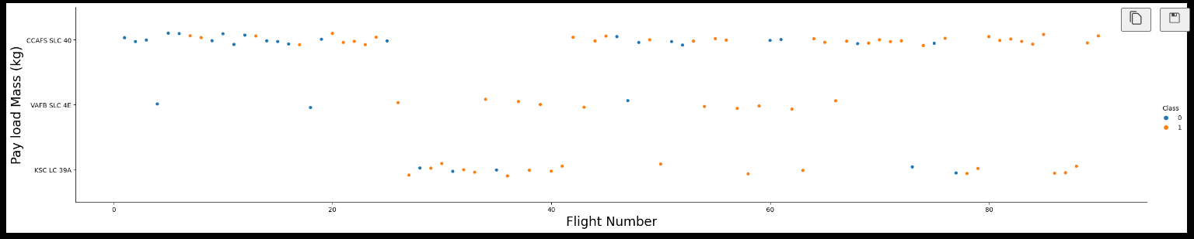
RESULTS
EDA done with Data Visualization
Scatter Plot showing the Flight Number and Payload Massa

Slide 12
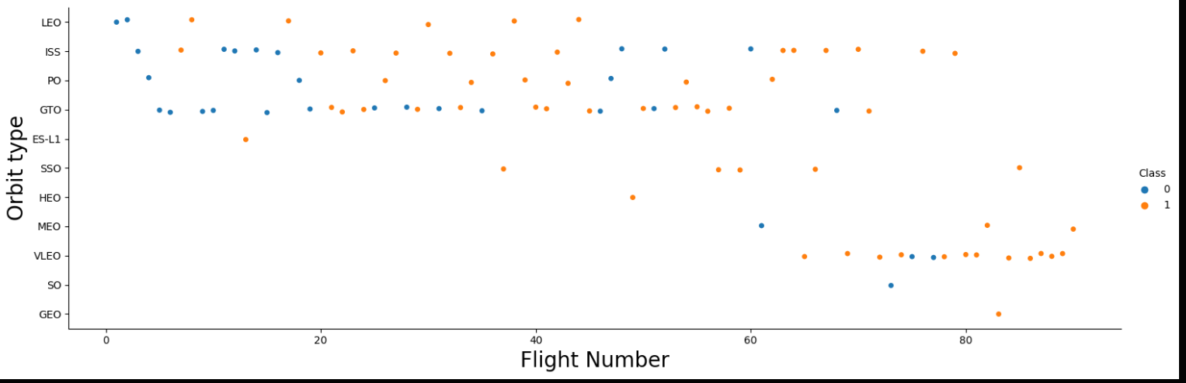
RESULTS
. Scatter Plot showing the relationship between Flight Number and Orbit Type

Slide 13
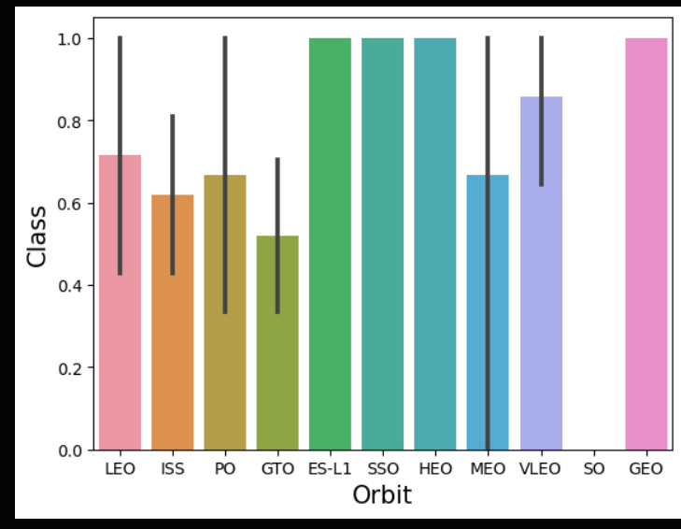
RESULTS
Bar Chart showing the Classes of Each Orbit.

Slide 14
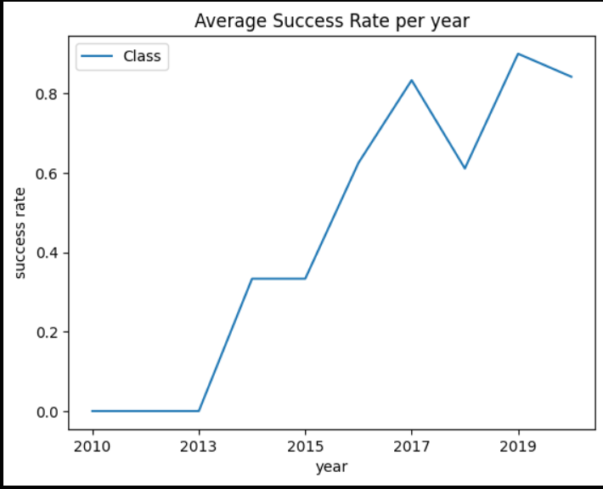
RESULTS
A Line Plot showing the Average Success rate per year

Slide 15
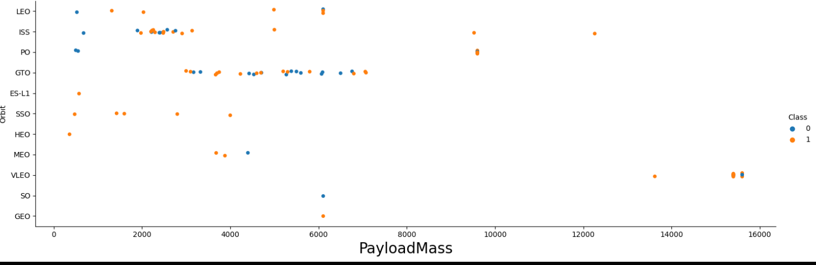
RESULTS
Scatter Plot showing the different Payload Masses of each Orbit

Slide 16
RESULTS
EDA with SQL
Display the names of the unique launch sites in the space mission Display 5 records where launch sites begin with the string 'CCA' Display the total payload mass carried by boosters launched by NASA (CRS)
Display average payload mass carried by booster version F9 v1.1
List the date when the first successful landing outcome in ground pad was achieved.
List the names of the boosters which have success in drone ship and
have payload mass greater than 4000 but less than 6000
List the total number of successful and failure mission outcomes
List the names of the booster_versions which have carried the maximum payload mass. Use a subquery
List the records which will display the month names, failure landing_outcomes in drone ship ,booster versions, launch_site for the months in year 2015
Rank the count of successful landing_outcomes between the date 04- 06-2010 and 20-03-2017 in descending order.

Slide 17
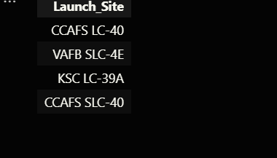
Display the names of the unique launch sites in the space mission

Slide 18
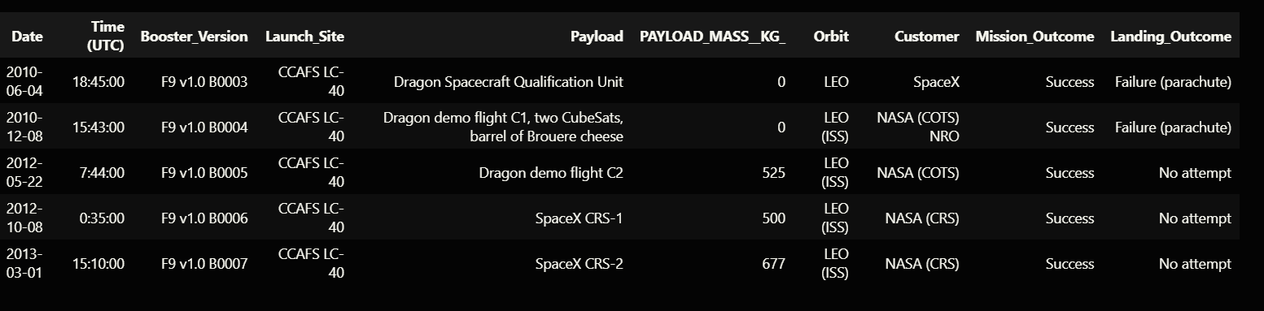
Display 5 records where launch sites begin with the string 'CCA'

Slide 19
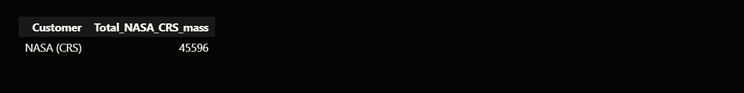
Display the total payload mass carried by boosters launched by NASA (CRS)

Slide 20
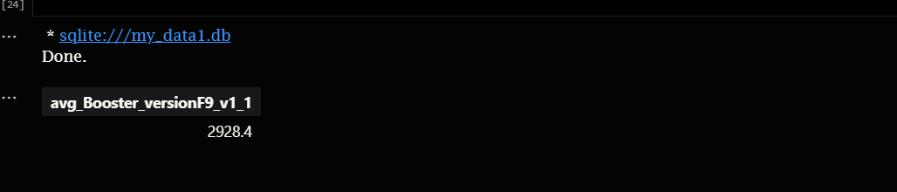
Display average payload mass carried by booster version F9 v1.1

Slide 21
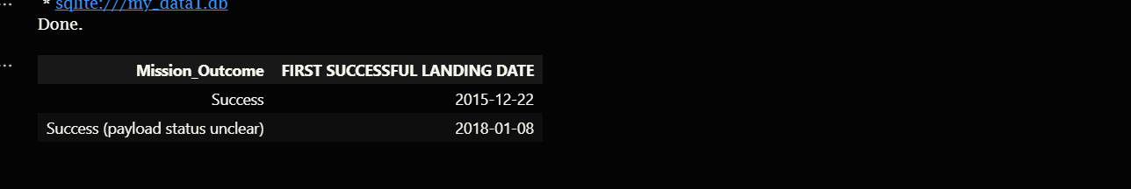
List the date when the first successful landing outcome in ground pad was achieved.

Slide 22
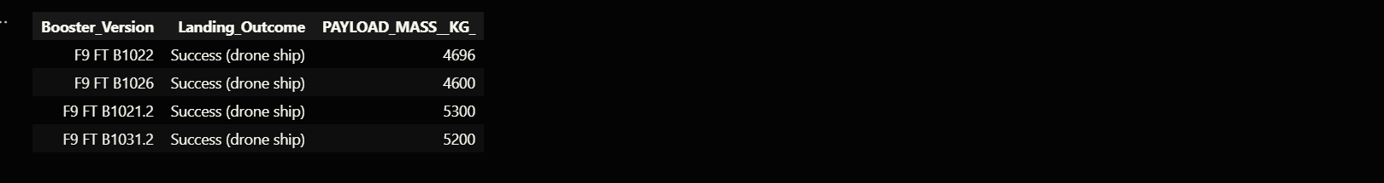
List the names of the boosters which have success in drone ship and have payload mass greater than 4000 but less than 6000

Slide 23
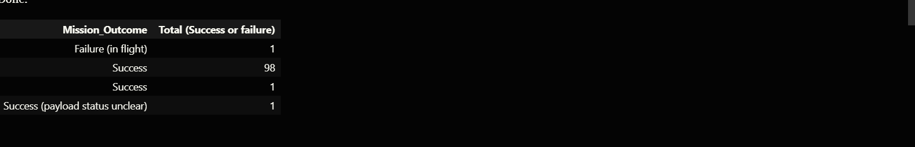
List the total number of successful and failure mission outcomes

Slide 24
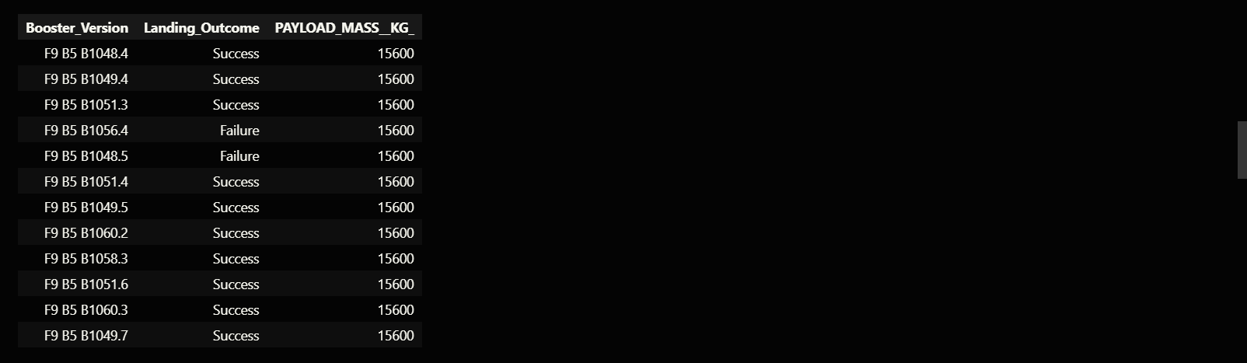
List the names of the booster_versions which have carried the maximum payload mass. Use a subquery

Slide 25
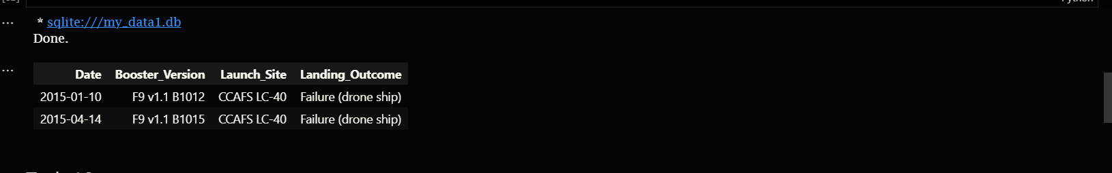
List the records which will display the month names, failure landing_outcomes in drone ship ,booster versions, launch_site for the months in year 2015.

Slide 26
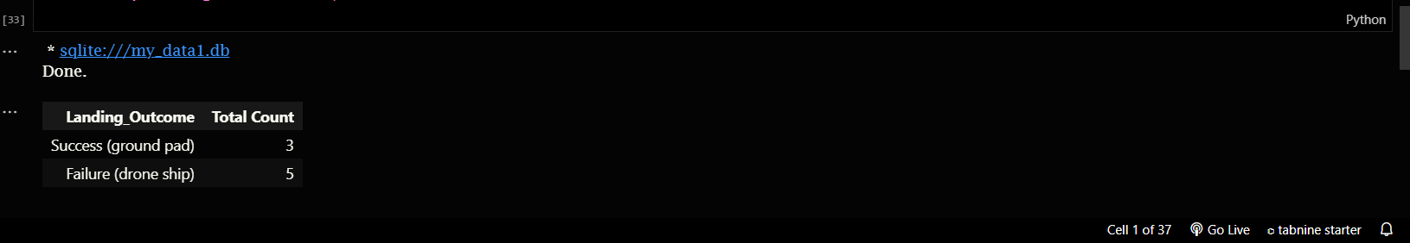
Rank the count of successful landing outcomes between the date 04-06-2010 and 20-03-2017 in descending order.

Slide 27
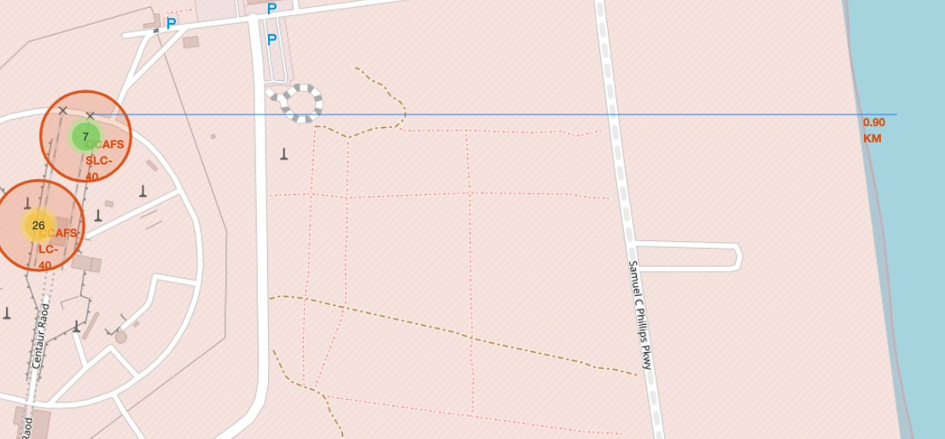
Interactive Visual Analytics with Folium
Mark all launch sites on a map
Mark the success/failed launches for
each site on the map
Calculate the distances between a
launch site to its proximities

Slide 28
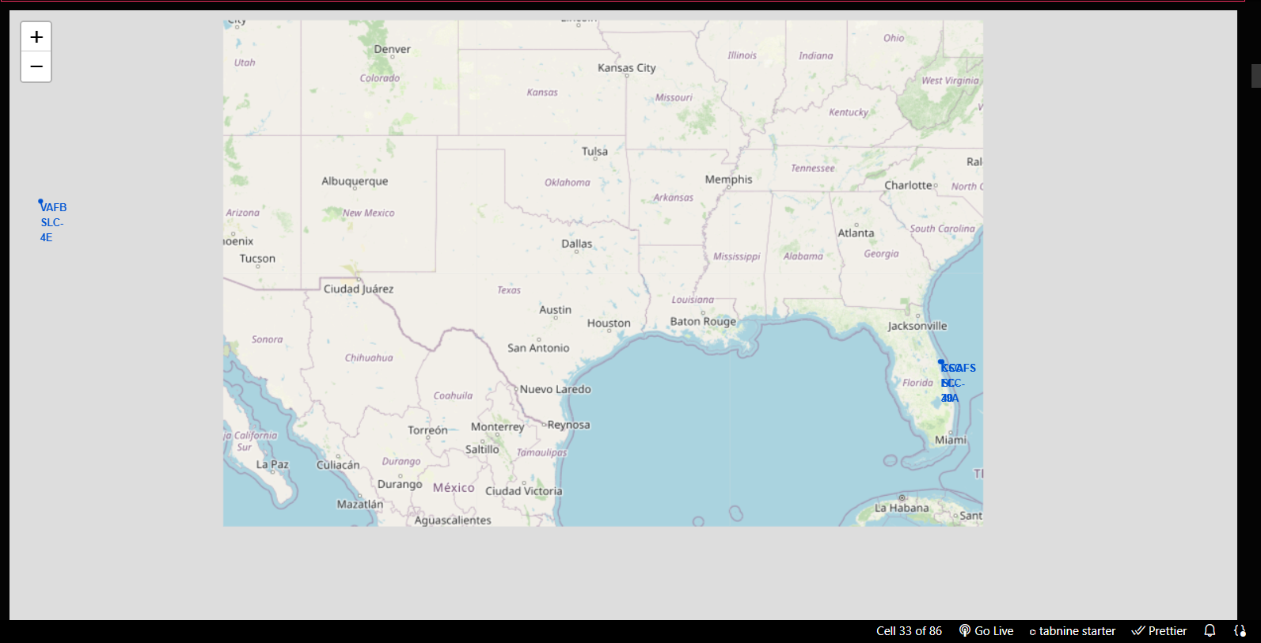

Slide 29
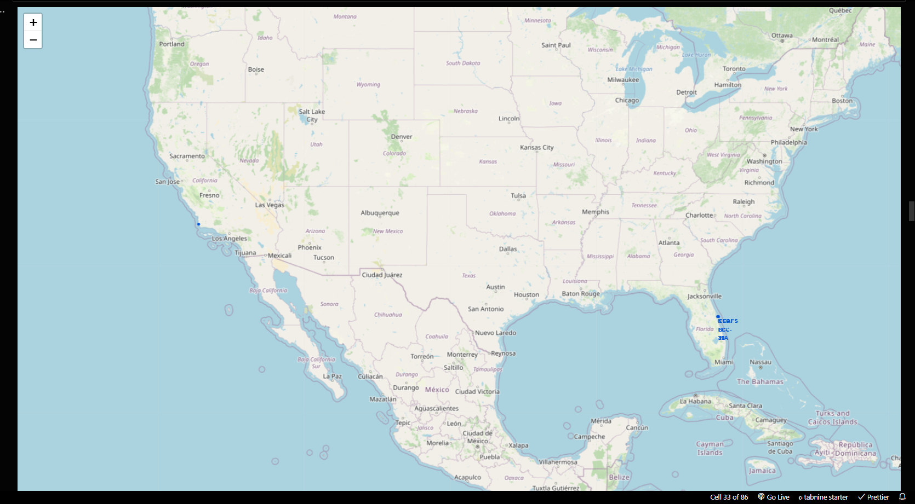

Slide 31
MACHINE LEARNING PREDICTIVE ANALYSIS
Create a NumPy array from the column Class in data, by applying the method to_numpy() then assign it to the variable Y,make sure the output is a Pandas series (only one bracket df['name of column’]).
Standardize the data in X then reassign it to the variable X using the transform provided below.
Use the function train_test_split to split the data X and Y into training and test data. Set the parameter test_size to 0.2 and random_state to
2. The training data and test data should be assigned to the following labels.
Create a logistic regression object then create a GridSearchCV
object logreg_cv with cv = 10. Fit the object to find the best parameters from the dictionary parameters.

Slide 32
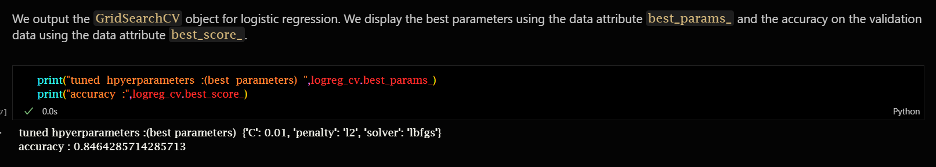
We output the GridSearchCV object for logistic regression. We display the best parameters using the data attribute best_params_ and the accuracy on the validation data using the data attribute best_score_.
Calculate the accuracy on the test data using the method score: 0.8333333333333334

Slide 33
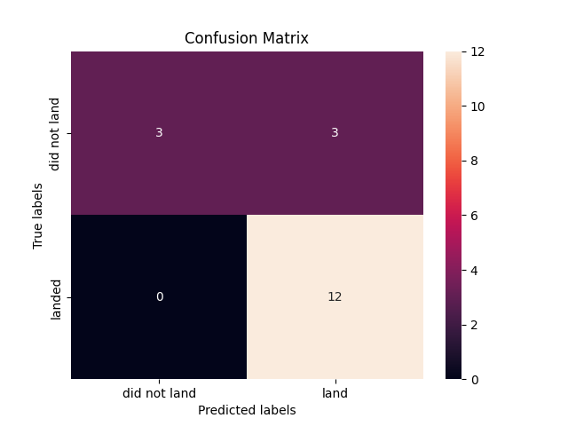
CONFUSION-MATRIX

Slide 34
Create a support vector machine object then create a GridSearchCV object svm_cv with cv - 10. Fit the object to find the best parameters from the dictionary parameters.
Accuracy: 0.8482142857142856
Calculate the accuracy on the test data using the method score:
Accuracy: 0.8333333333333334

Slide 35
Create a decision tree classifier object then create a GridSearchCV object tree_cv with cv = 10. Fit the object to find the best parameters from the dictionary parameters
Accuracy: 0.8714285714285713
Calculate the accuracy of tree_cv on the test data using the method score:
Accuracy: 0.8333333333333334

Slide 36
Create a k nearest neighbors object then create a GridSearchCV object knn_cv with cv = 10. Fit the object to find the best parameters from the dictionary parameters
Accuracy: 0.8482142857142858
Calculate the accuracy on the test data using the method score:
Accuracy: 0.8333333333333334

Slide 37
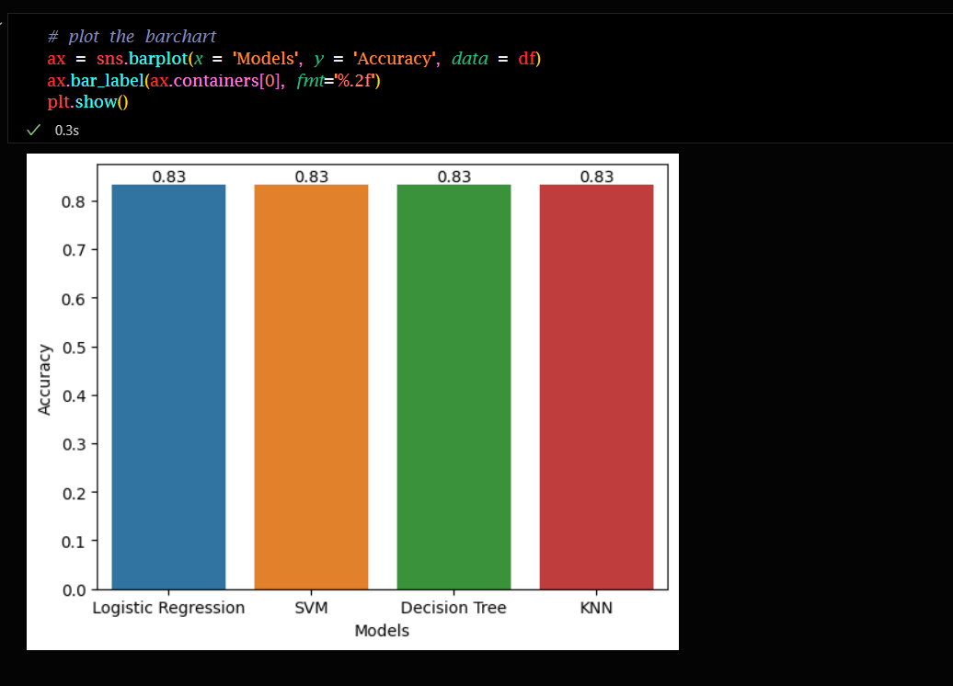
Bar-Plot Showing the Accuracy of The Algorithms

Slide 38

Conclusion Form the Machine-Learning Algorithm
"Practically all these algorithms give the same result"

Slide 39
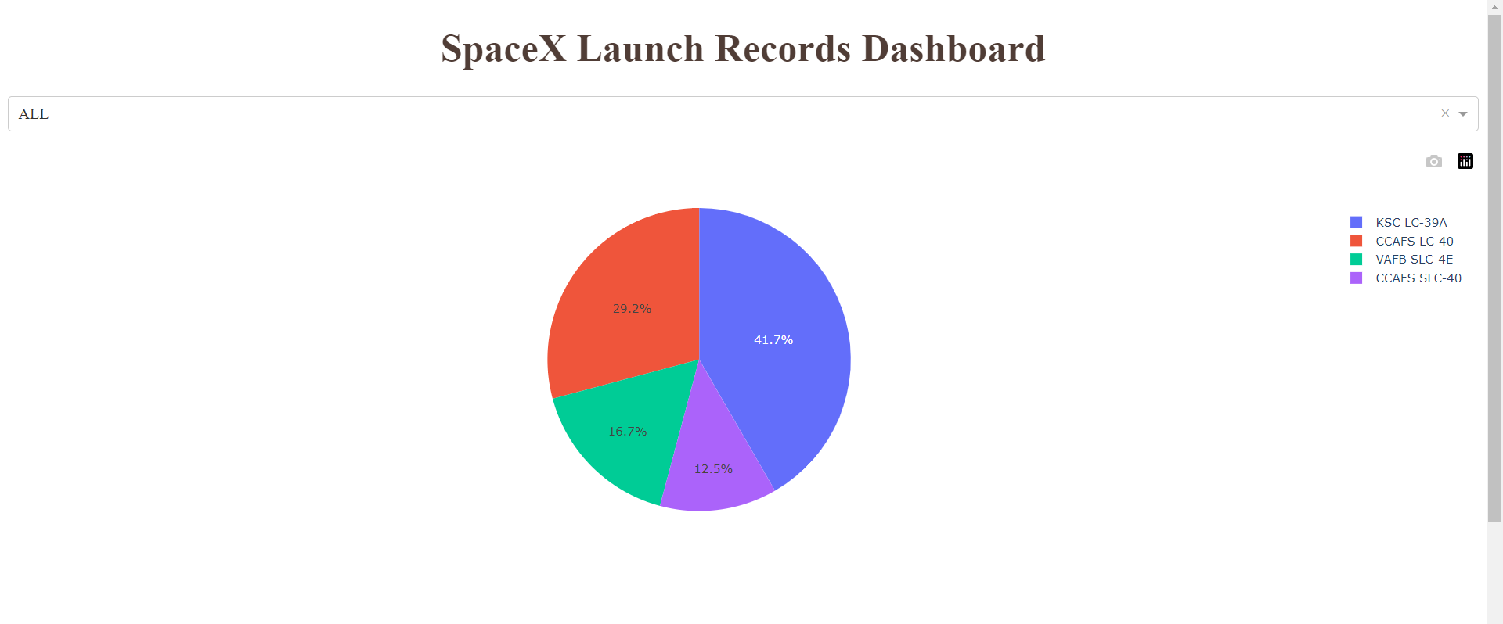
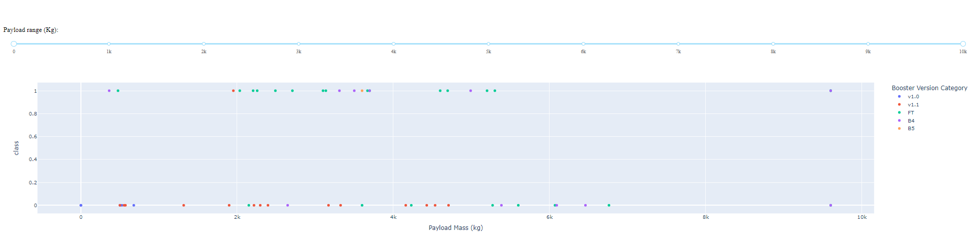
DASHBOARD

Slide 40
CONCLUSION
There is a correlation between launch site and success rate Payload mass is also associated with the success rate.: the more massive the payload, the less likely the first stage will return
For orbit type, SO has the least success rate while ES-L1, GEO, HEO and SSO have the highest success rate According to the yearly trend
There has been an increase in the success rate since 201 3 kept increasing till 2020 • With best parameter provided, decision tree classifier used in prediction yielded the highest accuracy of 84% .

Slide 41

THE END
Done By Yasser Shabbir

